Slide 1
Optimizing Mail Campaigns:
An Analysis of Costs and Earnings for Nonprofit Organization ABC
Jose Faz, Morgan Hellwig, Trisa Nguyen, and Ashley Pita University of North Texas ADTA 5230: Advanced Data Analytics II Dr. Anna George December 9, 2020
Notes:
Thank you for joining us today, as we review the study results for optimizing Nonprofit Organization ABC's mail campaigns. This presentation will cover the analysis process and findings from the study, as well as our recommendations for future campaigns. Questions will be welcomed at the end of the presentation.

Slide 2
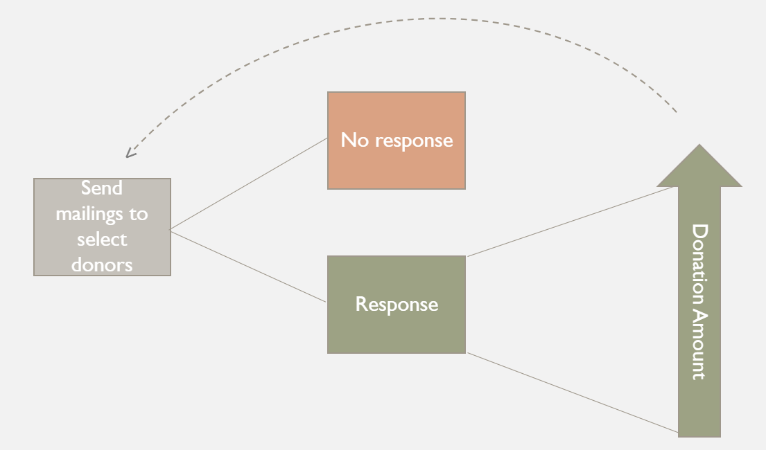
Business Understanding
Purpose: Maximize return on investment
Net Proceeds / Capital Investment = ROI
Costs - $2.00 per mailing
Current response rate – 10%
Questions
Which donors are most likely to respond?
What are the predicted donations amounts?
Who should our campaign recipients be to maximize ROI?
Notes:
Morgan (3.5 min total)
The overall goal of this analysis is to optimize the cost effectiveness for Nonprofit ABC's mailing campaigns. While cost effectiveness could be measured with a variety of metrics – such as profit per mailing or net profits for campaign – for the purposes of this project "cost effectiveness" is defined as the return on interest ratio. We are calculating ROI by net proceeds ("profits" or total funds gained minus total funds invested) over the total funds invested. Furthermore, invested funds, sometimes referred to as capital investment, is calculated using an estimated $2.00 per mailing. The current state response rate is captured at 10%.
So as the old saying goes, "you have to spend money to make money." But how can we ensure that not only do we make more money than we spend, but we optimize those earnings? Looking at the flow of our investments, there are two primary factors the determine the success of the campaign: does the mailing recipient respond with a donation, and of those that do respond what is the donation amount? Obviously we want to target those that most likely to respond, but we also want to understand what those potential donor's expected donations are. Analyzing these predictions together will allow us to better understand the expected risks and returns as we select recipients for our next mailing campaign.

Slide 3
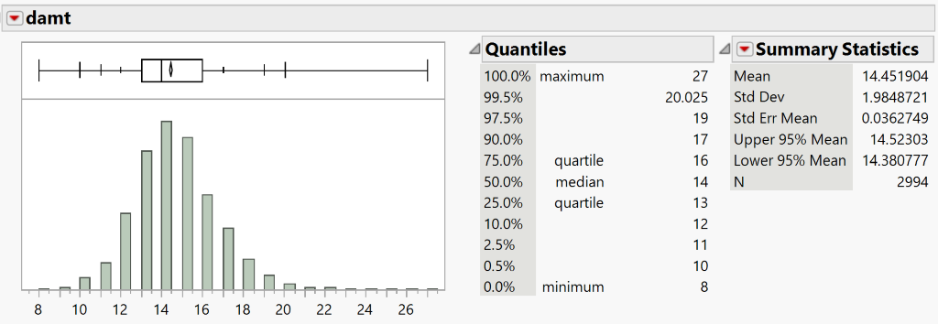
Data Understanding
Target variables
Classification – Donor (DONR)
Prediction – Donation amount (DAMT)
8,009 observations (data points from previous campaign)
3,984 training (weighted)
2,008 validation (weighted)
2,007 testing
22 variables – nominal, ordinal, and continuous
Notes:
Morgan (3.5 min total)
The available data on the previous mailing campaign contained 8,009 observations, or prior donors that were contacted during the campaign, each measured by 22 variables. As previously mentioned, the target variables for the models are donor response and donation amount. The classification target variable (donor response) is represented by "DONR," and the target prediction variable (donation amount) is represented as "DAMT" - this is how they will be referenced throughout the analysis.
While it is already known that the average response rate is 10%, more exploration was required for DAMT. A quick visual review reveals that donations were most concentrated at approximately $14.00, with a slight positive skew. This indicates that while the donations are mostly normally distributed, there are a few generous donations that cause the data mean to exceed the median donation. An initial review of each variable and it's relationship with the target variables also revealed some interesting points. For example: homeowners had a significantly higher donor rate than non-homeowners, those with average incomes had higher donor rates than those with the highest and lowest incomes, and donation amounts tended to increase as the total dollar amount of gifts to the donor increased.
It is important to note that for the purpose of this analysis the available data was divided into 3 groups: training, validation, and testing. To ensure each group was well represented, the training and validation sets were weighted to be equally balanced between donors and non-donors. The testing data set was not weighted. We then proceeded to prepare our data for the study, which Trisa will now review.

Slide 4
Data Preparation
To prepare the data for analysis, our team:
Updated data and model types of each variable in JMP
Normalized monetary variables
Added a nominal variable for whether a potential donor has kids
Excluded inconsistent variables from analysis
Identified highly correlated numeric variables
Log transformed numeric variables
Notes:
Ashley (2-2.5 min)
To ensure our data was ready to apply classification and prediction models, we went through various steps of data-cleanup and exploration. To start, we ensured each variable was coded correctly in JMP. Next, we ensured all monetary values were coded in the same units, as the raw data had some listed in dollars and others in thousands of dollars. This step yielded 3 new variables – HV_DOLLARS, INCMED_DOLLARS, and INCAVG_DOLLARS. We also added a binary nominal variable for whether potential donors were parents or not using the original KIDS variable.
After these initial updates to the dataset, we began reviewing the data for potential errors within variables. In exploring GIFDOL, GIFL, GIFR, and GIFA, we discovered several inconsistencies in these variables that introduced distrust. To determine which of these variables we wanted to keep, we analyzed the correlations between these variables and DAMT. GIFA had the strongest relationship with DAMT so we chose to keep using this variable and exclude GIFDOL, GIFL, and GIFR from further analysis.
After excluding those variables, we reviewed the correlation of all numeric variables, excluding KIDS. The results of this revealed a strong correlation between INCMED_DOLLARS and INCAVG_DOLLARS, HV_DOLLARS and LOW. Based on these results and the understanding that the median is less influenced by outliers or skewed data, we decided to exclude INCAVG_DOLLARS from future analysis. We also determined HV_DOLLARS and LOW would be excluded in models that assumed no multicollinearity among variables.
The last steps we took prior to applying models to our data was determining the distribution of our numeric variables and applying transformations to ensure more normally distributed variables. The initial review of distributions revealed most numeric variables had a slight to significant positive skew. Using a log transformation, we created new numeric variable. In most cases, these log transformed variables exhibited a normal distribution.
At this point, we were ready to apply classification and prediction models. To ensure the test data set was not considered during the initial model application, we excluded this partition from analysis.
Next, Trisa will discuss our modeling process as well as touching upon the key findings.

Slide 5
Modeling
Classification models
Decision Tree
Logistic Regression
Naïve Bayes
k-NN
Prediction models
Stepwise Linear Regression
Regression Tree
Bootstrap Regression Tree
Standard Least Squares
Notes:
Trisa (2.5-3 min total)
To predict likely donors in our test dataset, we applied 4 classification models for the DONR variable to the training and validation data and then we determined the best fit based on measures of accuracy and the maximum ROI associated with each model.
To predict donation amounts, we applied 4 prediction models for the DAMT variable to only donors in the training and validation data and then we determined the best fit model by comparing the predictive performance of each model.

Slide 6
Modeling (cont.)
Evaluation criteria
Classification models
Measures of accuracy
Sensitivity
Specifcity
Overall accuracy
Maximized Return on Interest (ROI)
Prediction models
High predictive accuracy (RASE)
Notes:
Trisa (2.5-3 min total)
The evaluation criteria we used for our classification models included assessing:
The measures of accuracy which includes:
Sensitivity, which indicates the model's ability to correctly classify donors.
Specifity, which tells us the model's accuracy to rule out non-donors.
Overall accuracy, which judges the ability of the model to correctly separate donors and non-donors.
And finally, the rate of ROI.
To assess our prediction models, we looked for high predictive accuracy by comparing the root average squared errors. The lower the RASE indicates better predictive accuracy.

Slide 7
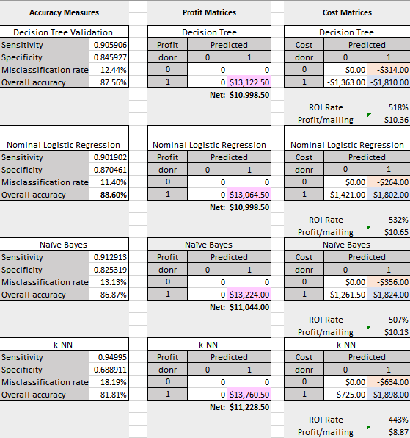

Costs/Benefits
Notes:
Trisa (2.5-3 min total)
To reiterate, to determine the best classification model, we evaluated the models based on measures of accuracy and the rate of return on interest (ROI) (net profit/cost of invest x 100%).
These cost and benefits matrices were created using the confusion matrixes of our classification models. According to our figures, the Nominal Logistic Regression model would be the most suitable classifier as it results in the highest rate of ROI and overall accuracy as well with a value of 88.6%.
While the sensitivity rate is lowest, suggesting a higher number of true donors classified as non-donors, the specificity rate is highest which means the least number of non-donors were wrongly classified as donors. These rates are important to consider when the goal is to maximize profits and minimize costs. We want to minimize false positives as this would lead to increased mailing cost and thus less profit per mailing.
For example, k-NN appears to have the highest net profit, however, this model misclassified more non-donors as donors, which increases mailing costs and lowers the specificity. This in turn decreases the rate of ROI as more capital needs to be invested.
Therefore, the Nominal Logistic Regression model is the best classification model as it is the most accurate and results in the highest rate of ROI of 532%.

Slide 8
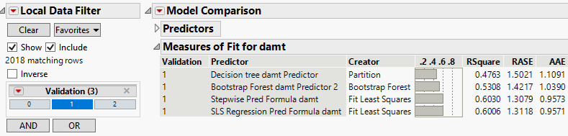
Predictive performance
Notes:
Trisa (2.5-3 min total)
To determine the best prediction model, we evaluated the models based on the root average squared error (RASE) criteria as this measures the accuracy of the prediction models. The lower the RASE, the more accurate the predictive capabilities of that model are.
Therefore, by looking at the model comparison output here of just our likely donors in the validation dataset, the model with the lowest RASE, and therefore better predictive accuracy, is the Stepwise Linear Regression model.
Next, Jose will be discussing the overall evaluation of our study and discuss further insights as to what our models can achieve.

Slide 9
Evaluation
Goals
Improve cost-effectiveness of direct marketing campaigns
Predict donations amounts
Maximize ROI
Notes:
Jose (3 min total)
The goals of this study are:
1) Improve cost-effectiveness of direct marketing campaigns by accurately classifying which donors are more likely to respond to the mailing campaign with a new donation,
2) Predict the donation amounts of responders that are in fact donors,
3) Maximize return on investment. By leveraging the resulting predictions from the two models, net proceeds and ultimately, ROI can be maximized.
4) Implement algorithms that we can re-use with new datasets from futures campaigns

Slide 10
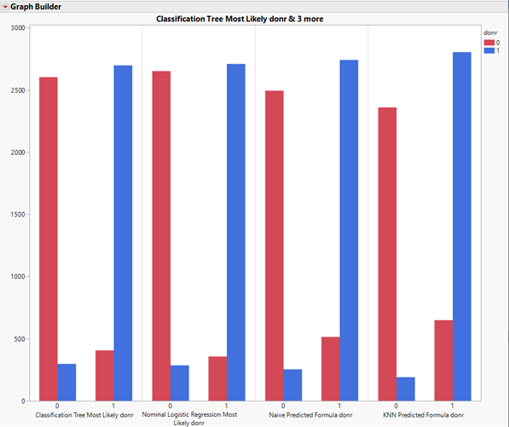
Best algorithm from Classification models
Nominal logistic regression classifier
Advantages regarding assumptions:
No linear relationship X/Y
Normality not needed
Homoscedasticity not needed
Assumptions:
Large data
Dichotomous output
Independent scores
Relevant and non-collinear predictors
Outcome exhaustive and mutually exclusive
Lowest error TYPE I
Notes:
The best classification model for this dataset is a Nominal Logistic Regression, because Sensitivity is 90.2%, False Positive = Error Type I = 12.8% (lowest), and Accuracy is 88.6% (the best). For the current dataset, this model is predicting that 416 donors.
Advantages: Linear relationship between dependent and independent variables, normality and homoscedasticity are not needed.
However other assumptions still apply:
- A large amount of observations is required,
- Our predicted variable is binary, hence is dichotomous, and it will score an outcome as: “non-donor = 0” and “donor = 1”.
- Our scores are independent of each other.
- Only relevant and non-collinear predictors are selected to be used in this model, and
- The two categories of the outcome variables are exhaustive and mutually exclusive, so a responder will be categorized as donor or non-donor, but not both

Slide 11
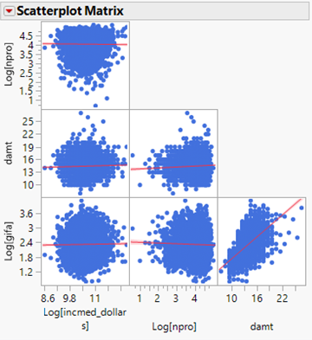
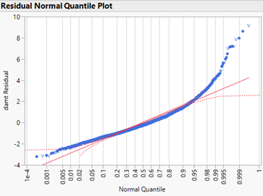
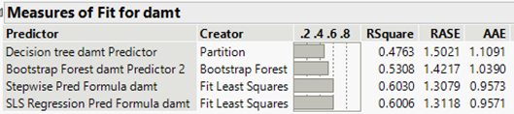
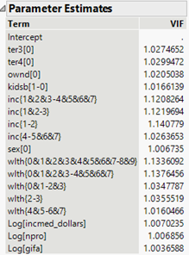
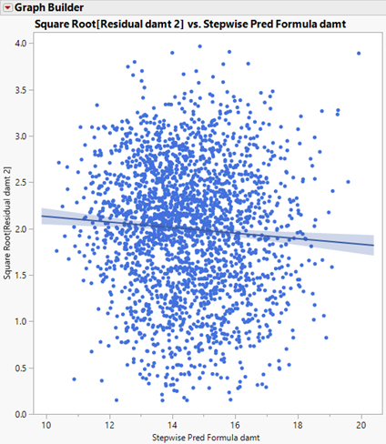
Best algorithm from Prediction models
Lowest RASE & highest R²
STEPWISE regression - PREDICTION
Assumptions:
Linear relationship
Multivariate Normality
Little/no Multicollinearity
Homoscedasticity
Notes:
As far as Prediction Models, Stepwise Regression is our best option because of the Lowest RSquare and Root Average Squared Error, 0.603 and 1.308 respectively.
Stepwise Regression follows some key assumptions:
Scatterplots show a linear relationship between the variable DAMT and the independent variables.
A Normal Quantile Plot confirmed Multivariate Normality, since residuals follow a line and are normally distributed.
Variance Inflation Factor (VIF) > 10, therefore no Multicollinearity is present.
The Standardized Residuals vs Predicted Values showed that points are equally distributed across all values of the independent variables, confirming Homoscedasticity

Slide 12
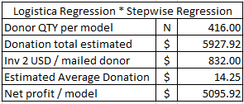
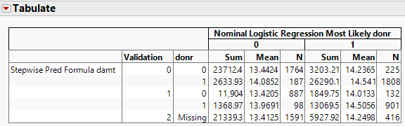
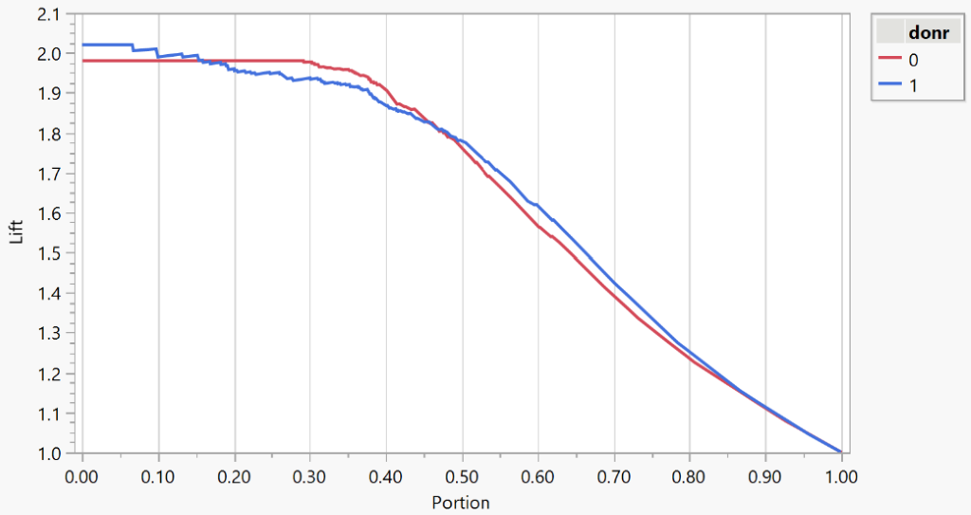
Cost effectiveness + predictions
Organization's Capital Investment
Target responders – must likely to be donors.
Predict expected gift amounts from donors
CLASSIFICATION
Lift Graph
PREDICTION
Notes:
To improve cost-effectiveness and obtain maximum net proceeds and ROI:
1- Accurately target responders in our sample who are most likely to donate – using Nominal Logistic Regression – Accuracy 88.6% and misclassifies 12.8%. These are important rates that affect net profits and capital investment and ultimately ROI.
2- Accurately predict the expected gift amounts from our likely donors – using Stepwise Regression we can achieve the highest predictive ability of expected gift amounts from likely donors.
By combining the classification and prediction models, an estimate of 416 donors would require the organization’s capital investment of $832, the estimated net proceeds would be $5096.92 after receiving an estimated average of $14.25 per donor, we can achieve up to 532% ROI. While this average is lower than $14.50 as stated in the beginning, the expected lift indicates that the nominal logistic regression model correctly identifies approximately 2 times the number of donors than random sampling when looking at the top 10% (portion 0.1) of a new sample of the same size (Lift Graph).
In conclusion, a direct marketing campaign utilizing these models would reach those who are likely to donate, thus maximizing net proceeds by keeping costs low.
Thank you

